Slide 1
Process As Code
Continuous Delivery of a CD Pipeline

Slide 2
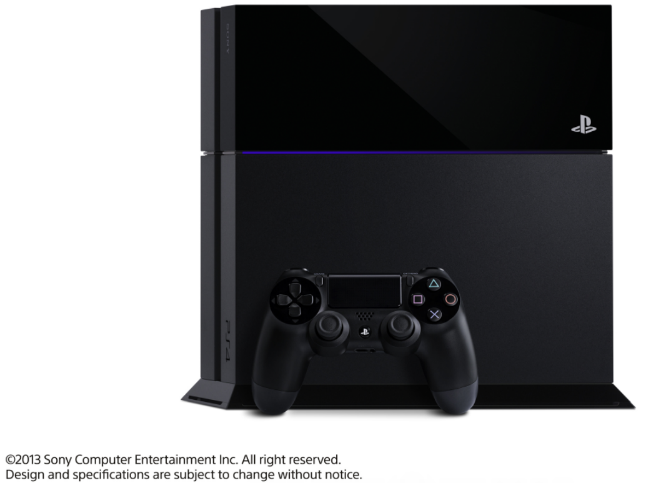

Slide 3







Notes:
Encompass Games, TV, Video And Music As A Premium Entertainment Service Brand.
By tying the network services under a single brand, SCE and SNEI will aim to further expand the network business by building upon the success of delivering the best all-round digital entertainment, and also extending the ultimate gaming and network entertainment experiences to an arena including movies, TV, and music.

Slide 4

Build/Deploy Tool History
Homegrown tool
Rsync
Build/Deploy tool
Build once, deploy many times
Reporting capabilities
Build/Deploy/Orchestration tool
Source controlled
Orchestrate releases between departments

Slide 5
What was the challenge?
Initial implementation of our new tool
Complex SDLC within CM
Potential for large downstream impact when changes were made
Time to market for new features for the build/deploy tool

Slide 6
Old CM Development Lifecycle
Prep
Copy
Objects
(Manual)
Rename
New
Objects
(Manual)
Update
Object
Def.
(Manual)
Copy
Template
(Manual)
Rename
Template
(Manual)
Update
Template Def.
(Manual)
Copy
Test Project
(Manual)
Update
Test Project
(Manual)
Apply
Templateto Prj.
(Manual)
Modify
Modify
Objects
(Manual)
Modify
Template
Props
(Manual)
Modify
Sandbox
Jar
(Manual)
Commit Sandbox
Jar
(Manual)
Build
Sandbox
Jar
(Manual)
Update
Objects
From Jar
(Manual)
Apply
Template
To Prj.
(Manual)
Review
Test
Changes
(Manual)
Submit Review Request
(Manual)
Review
Changes
(Manual)
Demo
Changes
(Manual)
Release
Merge Jar
Contents
(Manual)
Commit Prod.
Jar
(Manual)
Build Prod.
Jar
(Manual)
Update Objects From Jar
(Manual)
Move
Objects
(Manual)
Rename
Old Template
(Manual)
Rename
Dev Template
(Manual)
Apply Template to Prod.
(Manual)
Cleanup
Rename
Old
Objects
(Manual)
Rename
New
Objects
(Manual)
©2015 Sony Network Entertainment International
10/14/2015
6

Slide 7
Who was impacted?
The CM team as a whole
Coordination difficulties within the team
All work was handled in ad-hoc manner via tickets, face to face, phone calls, hallway meeting
Spaghetti code
Development
Completely unable to test changes before they went to the production system
SNEI

Slide 8
Change the mindset…
CM is a development team!!!

Slide 9
Evolution of the solution
Step 1: Get a handle on what work is coming in
Hallway conversations
Random tickets
Meetings
Emails
IM
Texts

Slide 10
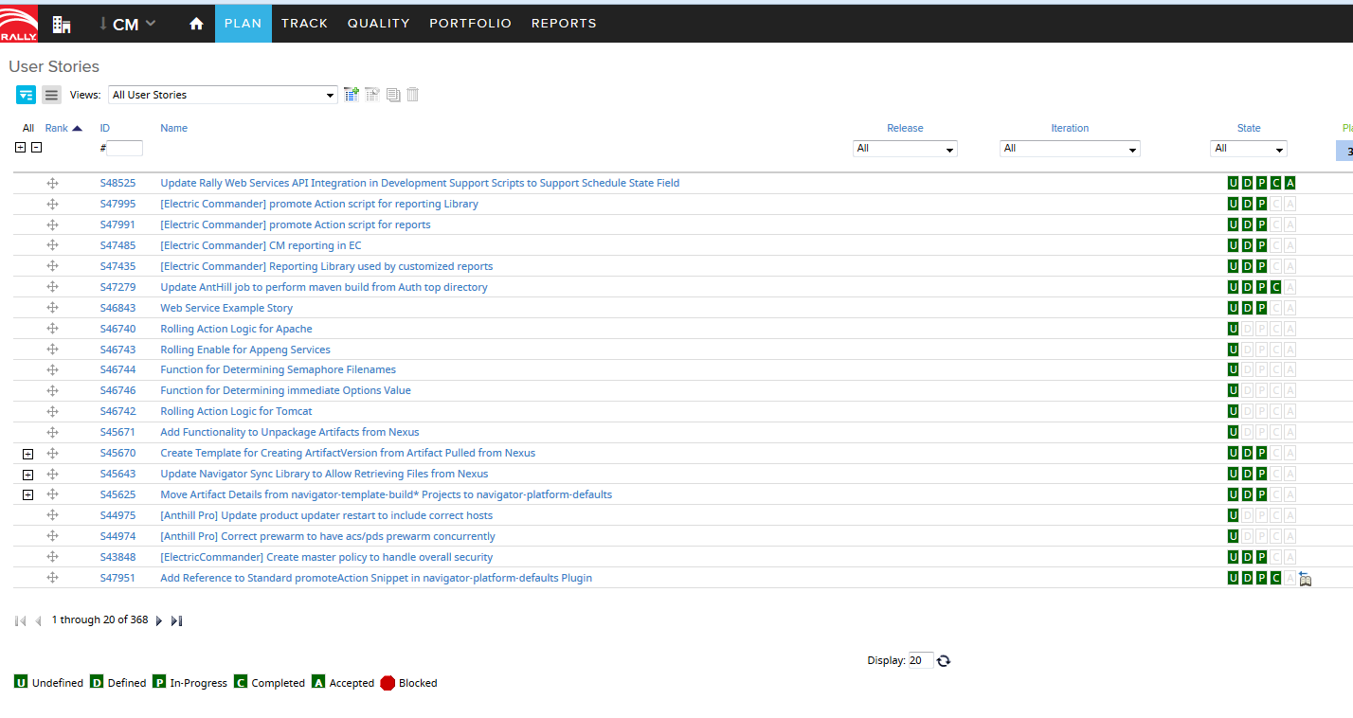

Slide 11
Evolution (cont)…
Step 2: Implement development practices within CM
Architect our deployment pipeline
Entire build/deploy system is in source control
Code review
Test systems

Slide 12



Architecting an Approach
Local Instance
Source Control
Test Instance
Repository
Production Instance

Slide 13

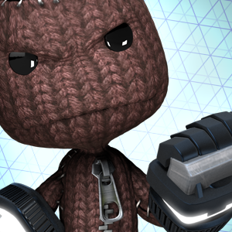
Development Environment
Approach #1: Install on Personal Laptops
Experience with install process
Experience with tools
Team can experiment freely
Different than production target environment
Non-standardized
Heavy reliance on manual steps

Slide 14
Development Environment (cont)
Approach #2: VM Definition with Homegrown Provisioning Script
Standardization - OS, Packages, etc.
Files all stored under source control
Automatic “rebuilding of the world”
Error handling
Difficulty in expressing tool dependencies
Difficulty in collaboration/handoff with other teams

Slide 15
Development Environment (cont)
Approach #3: VM Definition with Configuration Management Utility
Error handling built in/easier error identification
Explicit expression of dependencies
Collaboration/Handoff of CM Utility files
Certain permission issues masked by single VM
Couldn’t test some workflows due to collisions
Inter-host communications issues not identified

Slide 16
Development Environment (cont)
Current Approach: Multi-VM definition using Configuration Management Utility
Much closer to production setup
Able to test inter-host interactions

Slide 17
Local Instance
Source Control
Test Instance
Repository
Production Instance

Slide 18
Process As Code Development
How do we keep CM Development working?
Script/Automate
Creation of a new project
Setting work information
Rally Integration
Source control prep
P4 Integration
Review submission
Rally, P4, ReviewBoard Integrations
Source control commit

Slide 19
New CM Development Lifecycle
Create & Initialize Project
(Script)
Set Work Details
(Script)
Prep
Modify Project
(Manual)
Test
Changes
(Manual)
Modify
Prep Filesystem
(Script)
Export Project
Changes
(Script)
Create Changelist
(Script)
Add to Source Control
Submit Review Request
(Script)
Review Project Changes
(Manual)
Demo Changes
(Manual)
Review
Merge Project Changes
(Manual)
Commit Project Changes
(Script)
Submit in Source Control

Slide 20
Local Instance
Source Control
Test Instance
Repository
Production Instance

Slide 21
Releasing Changes
Test Instance
CI Trigger on changes in source control
Builds and deploys plugin
Plugin artifact is published to repository
Final validation for changes on Test Instance
Approval makes call to Production Instance

Slide 22
Local Instance
Source Control
Test Instance
Repository
Production Instance

Slide 23


Releasing Changes (Cont.)
Production Instance
Approval call from Test Instance retrieves plugin from repository
Deploys plugin to production instance
Users can immediately take advantage of new features

Slide 24
For anyone else getting started
Lessons learned
Tool sets
Baby steps
Patience
Communication

Slide 25


Questions?

